Slide 1

N.O.W. Financial Capability Program
Neighborhood Opportunities for Wealth
“Our only hope today lies in our ability to recapture the revolutionary spirit and go out into a sometimes-hostile world declaring eternal hostility to poverty, racism, and militarism…...We are now faced with the fact that tomorrow is today. We are confronted with the fierce urgency of now. In this unfolding conundrum of life and history there is such a thing as being too late. Procrastination is still the thief of time. Life often leaves us standing bare, naked and dejected with a lost opportunity.”
Dr. Martin Luther King Jr.

Slide 2


Slide 3


Slide 4


Slide 5
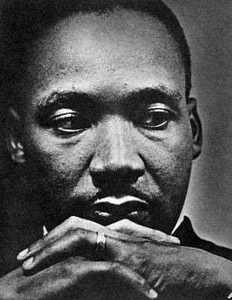
Program Objectives
Mitigate Displacement for vulnerable residents
Create bankable households and economic mobility
Establish Affordable Housing Eligibility and Connectivity
Increase homeownership
Train and build the workforce for livable wage careers
Establish Micro Enterprise Capacity Building, New Entrepreneurship and Financing
Provide Wrap Around Services: Records Expungement, GED, Driver’s License Recovery, Child Support Services
Establish Banking Partner Asset Accounts and Loans
Deploy Asset and Wealth Building Resources
Driven by the Grove Park Foundation’s commitment to anti-displacement efforts and strong desire to provide legacy and new residents with economic mobility and affordable housing opportunities that help pave their path toward substantiable tenure in the greater Grove Park community, the NOW Program was intentionally crafted as an equity focused anti-displacement model that is inspired by Dr. Martin Luther King Jr.’s April 1967 speech in which he orated about “the fierce urgency of now”

Slide 6
N.O.W. Program: Neighborhood Opportunities for Wealth
Program Goals
Increase household incomes to livable wages for Grove Park residents and families living in 30318 and parts of 30314.
Create at least 10 new community-based businesses and grow capacity for at least 5 existing businesses.
Provide financial literacy training and create 1,500 bankable residents.
Provide a pipeline of 500+ qualified renters and/or homebuyer for new affordable housing development by 2022.

Slide 7
1. Financial Literacy Education and Credit Building
2. Affordable Housing Eligibility and Connectivity
3. Job Training and Placement
4. Micro Enterprise Capacity Building, New Entrepreneurship &
Financing
N.O.W. Program Components
Core Program Tracks
5. Wrap Around Services: Records Expungement, GED, Driver’s
License Recovery, Child Support Services
6. Banking Partner Asset Accounts and Loans
7. Deployment of Asset and Wealth Building Resources
Core Services & Resources

Slide 8
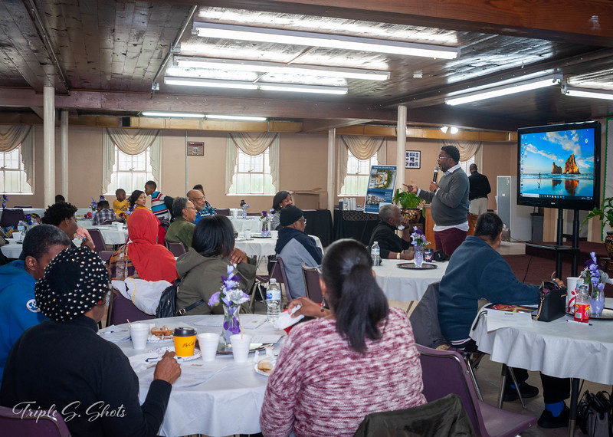
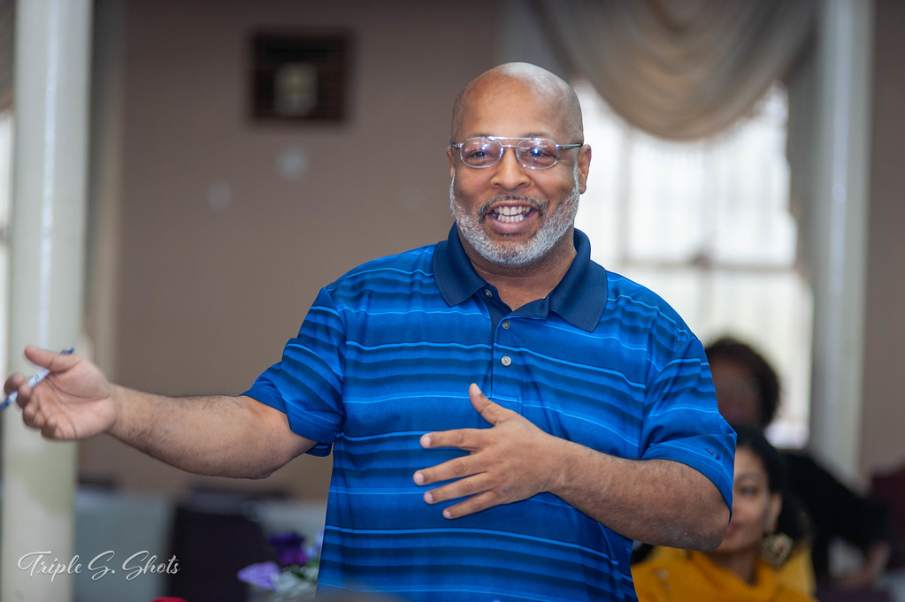
Target Participants
Renters
Homebuyers
Homeowners
Veterans
Seniors
Aspiring Entrepreneurs
Small Business Owners
Underemployed
Unemployed
Legacy Residents & Families
8

Slide 9
Program Service Area
Grove Park . 30318 . 30314 Neighborhood Specific [Hunters Hills, West Lake, Dixie Hills, Harvel Homes, Collier Heights]
9

Slide 10
Income Targets
NOW Program eligibility is limited to participants whose incomes are 80% AMI or below.
Number in Household | 80% or less AMI Household Income Limit
1 | $48,300
2 | $55,200
3 | $62,100
4 | $68,950
5 | $74,500
6 | $80,000
7 | $85,500
8 | $91,050
10

Slide 11
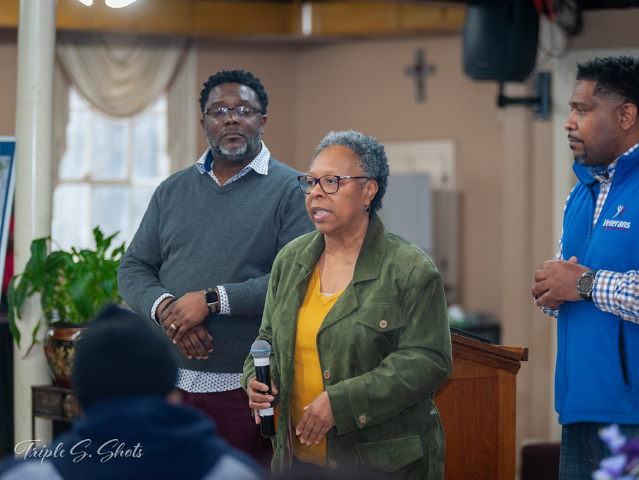
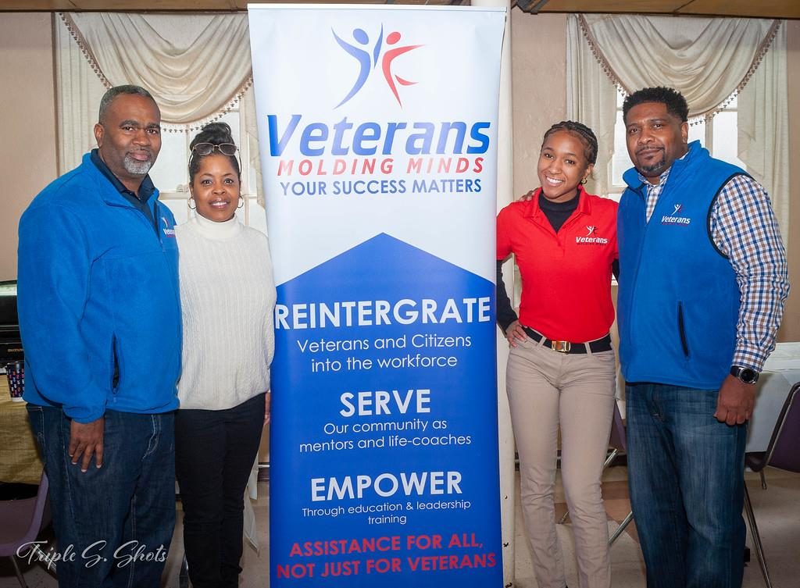
Affinity Partners
  Financial Literacy Partners
  Community Sustainability Enterprise
  Atlanta Economic Mobility Collaborative
  Greater Atlanta Builds Credit (GABC)
  Workforce Development & Job Training
  Veterans Molding Minds (VMM)
  Westside Works
  WorkSource Atlanta
  Integrity CDC
  Micro Business and Entrepreneurship
  Access to Capital for Entrepreneurship
  Urban League of Greater Atlanta
  Russell Center for Innovation (RCIE)
  Atlanta Wealth Building Institute (AWBI)
  Housing Partners
  H.O.P.E. for Divine Intervention
  Paradise CDC
11
11

Slide 12






Slide 13
Grove Park Foundation Team:
Intake, Validation, Assessment, Triage, Partner Coordination, Monitoring & Tracking
Core Affinity Partners:
Full Assessment, Workshops, One-on-One Coaching, Eligibility Confirmation
Banking Partners:
Expanded Accounts and Loans, Wealth Building Workshops & Sponsorship
Step 1: Intake: Complete Intake form or interview with program administration staff
Step 2: Participant Eligibility: Address (live and/or work) and income (80% and below Area Median Income).
Step 3: Benchmarking: Complete initial/benchmark budget worksheet and credit review.
Step 4: Assessment: Detailed review of participant’s economic/self-sufficiency status: budget, credit, housing, employment, income, assets, record expungement/GED/DL/CS clearance (as applicable).
Step 5: Group Workshop Enrollment: Advanced participant registration for live and virtual group workshops.
Step 6: Core Partner Referral: Assignment to N.O.W. Financial Capability Partner [Financial Management, Job Training, Micro Enterprise]
Step 7: One-on-One Coaching: Direct and personal financial management and credit building consultations.
Step 8: Establish Accounts: If applicable, Open checking/savings account and/or credit account
Step 9: Asset Building Event Participation: Define participant asset building workshop and resource plan.
Step 10: Program Graduation/Certification: Completion of 80% of outlined benchmark goals.

Slide 14

NEXT STEPS
Complete the Intake Application Form
Complete Intake Questionnaire within 48 hours.
Schedule an Assessment Appointment
Referral to a Partnering Agency

Slide 15
WAYS TO CONTACT US
(404) 301-4466, press 3
Intake@GroveParkFoundation.org www.groveparkfoundation.org

